Slide 1
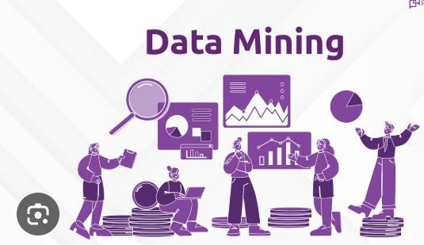
Data Mining
Data mining is the process of extracting and discovering patterns in large datasets involving methods at the intersection of machine learning, statistics, and database systems

Slide 2
Key concepts:
Data: The raw material that is analyzed.
Mining: The process of extracting valuable information.
Patterns: The relationships and trends discovered in the data.

Slide 3
Techniques
Classification: Assigning data points to predefined categories.
Regression: Predicting numerical values.
Clustering: Grouping similar data points together.
Association Rule Mining: Identifying relationships between variables.
Anomaly Detection: Finding outliers or unusual patterns

Slide 4
Applications
Marketing: Customer segmentation, targeted advertising, market basket analysis.
Finance: Fraud detection, risk assessment, credit scoring.
Healthcare: Disease diagnosis, drug discovery.
Telecommunications: network optimization.
E-commerce: Recommendation systems, personalized marketing

Slide 5
Benefits
Improved decision-making: Data-driven insights lead to better decisions.
Increased efficiency: Automation of tasks and optimization of processes.
Competitive advantage: Gaining insights before competitors.
Enhanced customer experience: Personalized offers and recommendations

